Slide 1
ENGINEERING GRAPHICS
Topic:
Scales

Slide 2

Scales
It is always possible or convenient to make the linear dimensions on a drawing the same size as the corresponding real dimensions on the object drawn. For eg. Drawing of a mobile phone.

Slide 3
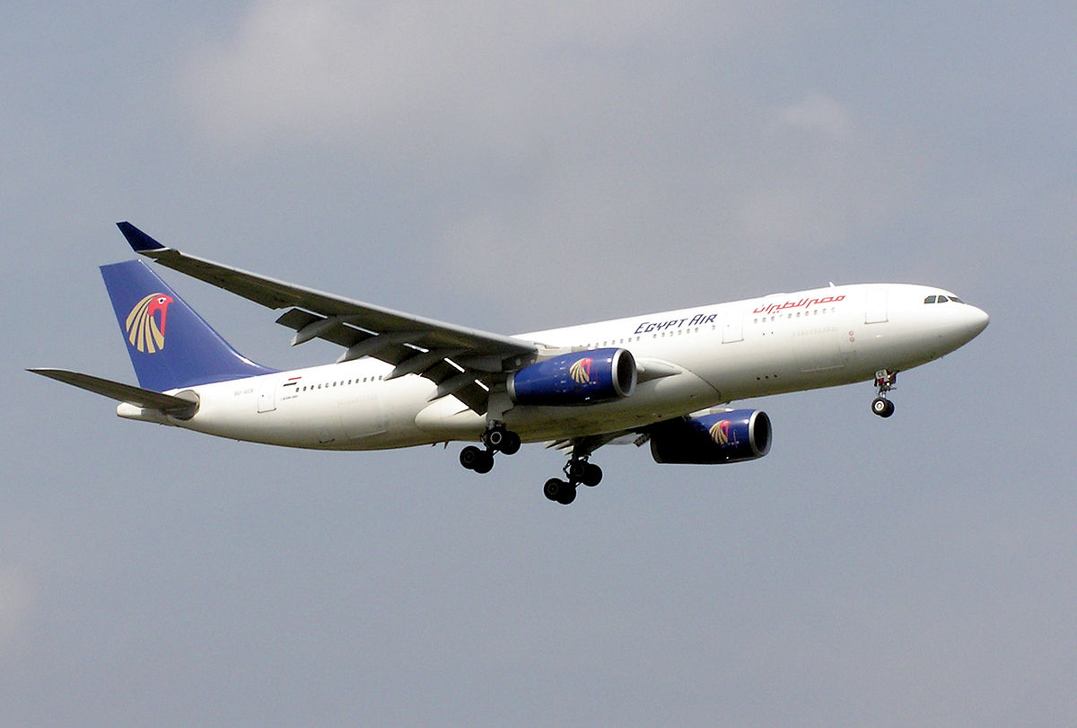
Scales
Drawing of very big object, like aeroplane, must perforce, be drawn considerably smaller than the object so that the drawing can be read and handled with convenience.

Slide 4
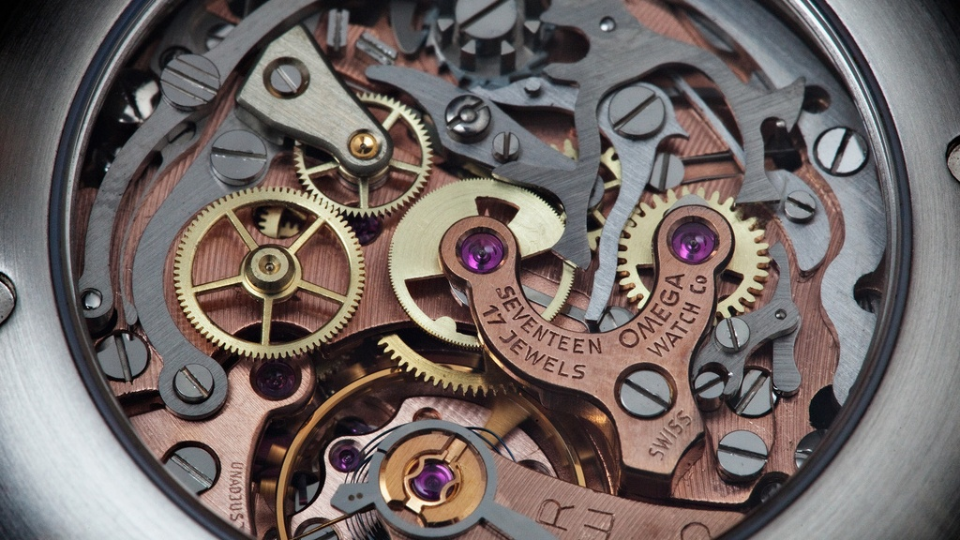
Scales
Where as, details of small precision instruments, watches etc.; are made larger than their real size so that the drawing can be read clearly.

Slide 5
Scales
The proportion by which the drawing of a given object is enlarged or reduced is called the scale of the drawing.

Slide 6
Representative Fraction
The scale of a drawing is indicated by a ratio, called the Representative Fraction (RF) or Scale Factor.
Length of a line in the drawing
RF = -----------------------------------------------
Actual length of the line on the object
The terms ‘scale’ and ‘RF’ are synonymous. The scale is most commonly expressed in the format X :Y while RF is expressed in the format X/Y.

Slide 7
Sizes of Scale
Reducing Scale.
Enlarging Scale.
Full Scale.

Slide 8
Sizes of Scale
1. Reducing Scale
When huge objects are to be drawn, they are reduced in size on the drawing. The scales used for these objects are called reducing scales. It is clear that the length of the object on the drawing is less than the actual length of the object. Reducing scales are mentioned in the format 1 :Y, where Y is greater than 1. Hence, RF < 1.
For eg:- 1:2 means drawing made to one HALF of the actual size.
Objects like multi-storeyed buildings, bridges, boilers, huge machinery, ships, aeroplanes, etc., are drawn to reducing scales.

Slide 9
Sizes of Scale
2. Enlarging Scale
When smaller objects are to be drawn, they often need to be enlarged. The scales used in such cases are called enlarging scales. Obviously, the length of an object on the drawing is more than the corresponding actual length of the object. Enlarging scales are mentioned in the format X : 1, where X is greater than 1. Clearly, RF > 1.
For eg: - 2:1 means drawing made to twice the actual size
Enlarging scales are used for objects like screws and gears used in small electronic gadgets, wristwatch parts, resistors, transistors, ICs.

Slide 10
Sizes of Scale
3. Full Scale
When an object is drawn on the sheet to its actual size, it is said to be drawn to full scale. As the length on the drawing is equal to the actual length of the object, the full scale is expressed as 1:1. Obviously, for full scale, RF = 1.
Full scales are used for objects like mobile phone, calculators, etc.

Slide 11
Types of Scale
Plain Scale or Simple Scale
Diagonal Scale

Slide 12
Conversions
1 Km = 10 Hectometer
1 Hectometer = 10 Decameter
1 Decameter = 10 Meter
1 Meter = 10 Decimeter
1 Decimeter = 10 Centimeter
1 Centimeter = 10 Millimeters

Slide 13
Types of Scale
Plain Scale:
It is a line divided into suitable number of equal parts or units, the first part of which is subdivided into small parts.
It represents either 2 main units or 1 unit and its sub division (fractions).
It can measure lengths up to 1 decimal place. (eg: 3.5 m, 2.7 cm)

Slide 14
Types of Scale
2. Diagonal Scale:
In diagonal scale the smallest unit on plain scale is further subdivided by using diagonal principle.
It represents either 3 units or only one unit and its fractions up to second place of decimal point.
It can measure lengths upto 2 decimal place. (eg: 3.56 m, 2.78 cm)

Slide 15
Construct a Plain Scale to show meters & decimeters when 1 m is represented by 2.5 cm. The scale should be long enough to measure up to 6 m. Mark off 3.3 m & 5.6 m on the scale.

Slide 16
Problem 1
Construct a Plain Scale to show meters & decimeters when 1 m is represented by 2.5 cm. The scale should be long enough to measure up to 6 m. Mark off 3.3 m & 5.6 m on the scale.
1. Calculate Representative Factor,
Length of a line in the drawing 2.5 cm
RF = ----------------------------------------------- = ----------
Actual length of the line on the object 1 m
2.5 cm 1
RF = --------------- = ---------
1 x 100 cm 40
2. Calculate length of scale (L.O.S),
LOS = RF x Maximum length of scale = 1/40 x 6 m = 1/40 x 600 cm
= 15 cm

Slide 17
Problem 1
Construct a Plain Scale to show meters & decimeters when 1 m is represented by 2.5 cm. The scale should be long enough to measure up to 6 m. Mark off 3.3 m & 5.6 m on the scale.
5.6
3.3
10
6
3
0
1
2
3
4
5
5
DECIMETERS
METERS
RF = 1/40
LOS = 15cm

Slide 18
Q 2. Construct a Plain Scale to show kilometers & hectometers when 2.5 cm is equal to 1 km. The scale should be long enough to measure up to 6 km. Mark off 2.7 km, 3.9 km & 4.5 km on the scale.

Slide 19
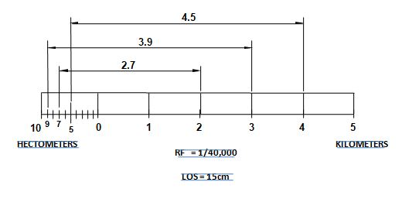
Problem 2
Q 2. Construct a Plain Scale to show kilometers & hectometers when 2.5 cm is equal to 1 km. The scale should be long enough to measure up to 6 km. Mark off 2.7 km, 3.9 km & 4.5 km on the scale.
RF = 2.5 cm/1 km = 2.5/100000 = 1/40000
L.O.S = (1/40000) X 6 km
    = (1/40000) X 6 X 100000 cm
    = 15 cm

Slide 20
Q 2. Construct a Plain Scale to show kilometers & hectometers when 2.5 cm is equal to 1 km. The scale should be long enough to measure up to 6 km. Mark off 2.7 km, 3.9 km & 4.5 km on the scale.

Slide 21
Problem 3
Construct a diagonal scale to show meters, decimeters & centimeters when 1 m is represented by 5 cm. Consider maximum length of scale as 4 m. Mark off 2.58 m & 3.09 m.
1. Calculate Representative Factor,
Length of a line in the drawing 5 cm
RF = ----------------------------------------------- = ----------
Actual length of the line on the object 1 m
5 cm 1
RF = --------------- = --------
1 x 100 cm 20
2. Calculate length of scale (L.O.S),
LOS = RF x Maximum length of scale = 1/20 x 4 m
= 1/20 x 4 x 100 cm
= 20 cm

Slide 22
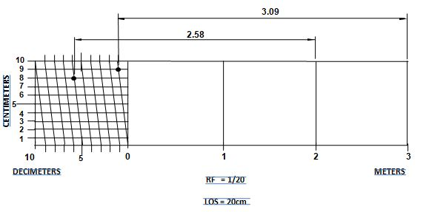
Problem 3
Construct a diagonal scale to show meters, decimeters & centimeters when 1 m is represented by 5 cm. Consider maximum length of scale as 4 m. Mark off 2.58 m & 3.09 m.

Slide 23
Q . The distance between two stations is 100 Km and it is represented on a map by a line of 2.5 cm. Draw a diagonal scale showing single Km. Mark off 409 Km & 573 Km on the scale.

Slide 24
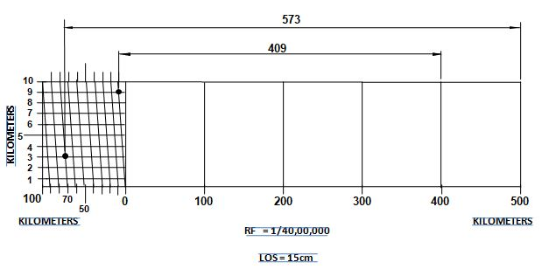
Problem 4
Q 6. The distance between two stations is 100 Km and it is represented on a map by a line of 2.5 cm. Draw a diagonal scale showing single Km. Mark off 409 Km & 573 Km on the scale.
RF = 2.5 cm/100 km = 2.5/(100x 100000)
= 1/4000000
2. L.O.S = (1/4000000) X 600 km
    = (1/4000000) X 600 X 100000 cm = 15 cm
Note:
Maximum length of scale is not given.
But the maximum distance to show is 573 Km.
So take maximum length of scale as 600 Km.

Slide 25
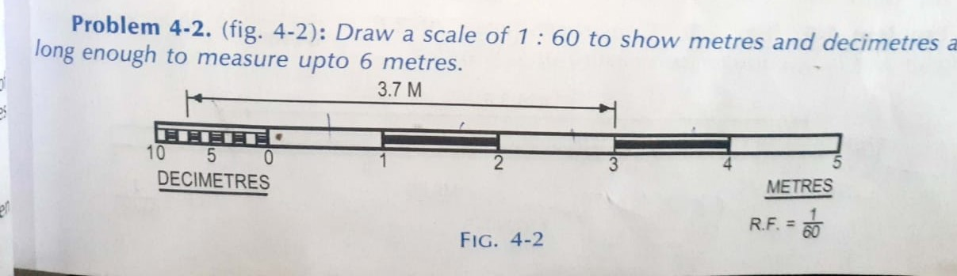

Slide 26
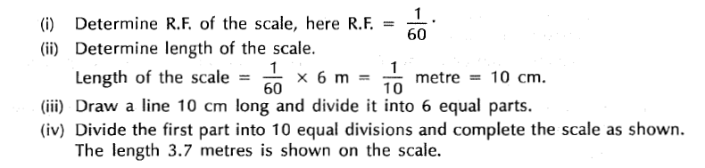

Slide 27
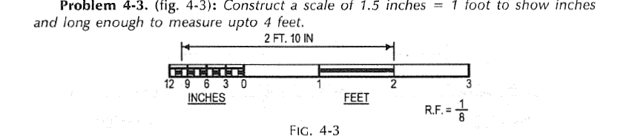

Slide 28
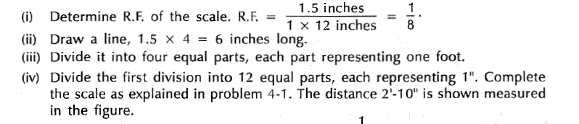

Slide 29
Thanks

Slide 30
Distance between Ludhiana and Chandigarh is 100 Km and is represented on a certain map by a line of 2.5 cm long. Find R.F. Draw diagonal scale showing single km. and long enough to measure up to 600 km. Indicate distance 473 km on scale

Slide 31
Construct a diagonal scale of 01:50. to show meter, decimeter and centimeter and long enough to measure up to 6 m. also indicate on this scale a distance of 4m, 5dm, and 4cm.

Slide 32
Construct a plane scale of 1 cm = 1m t o read meter and decimeter and long enough to measure up to 14 m. show in this scale a distance of 11.4 meter

Slide 33
Draw a scale of 01:50 or of representation factor 1/50 to show meter and decimeter and long enough to measure up to 6m. Show 2.3 meter on this scale.

